Slide 1
Completing the PHNST in Northern Loudoun November 2022

Slide 2
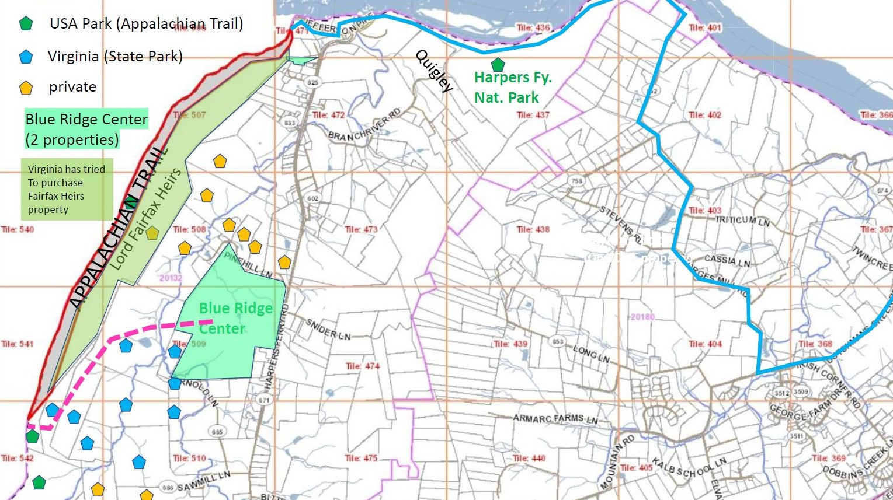
Harpers Ferry
Loudoun Hts
Devil’s Elbow
Buzzard
Rock
Planned
Route for
PHNST
Georges Mill Rd.
Short Hill Mountain
Private Property
To
Lovettsville &
Leesburg
Two Major Steps Needed
Land Acquisition (LWCF)
Reopen Loudoun Hts Trail
(formerly part of the Appalachian Trail)
(HFNP and VDOT land)
State
Park

Slide 3
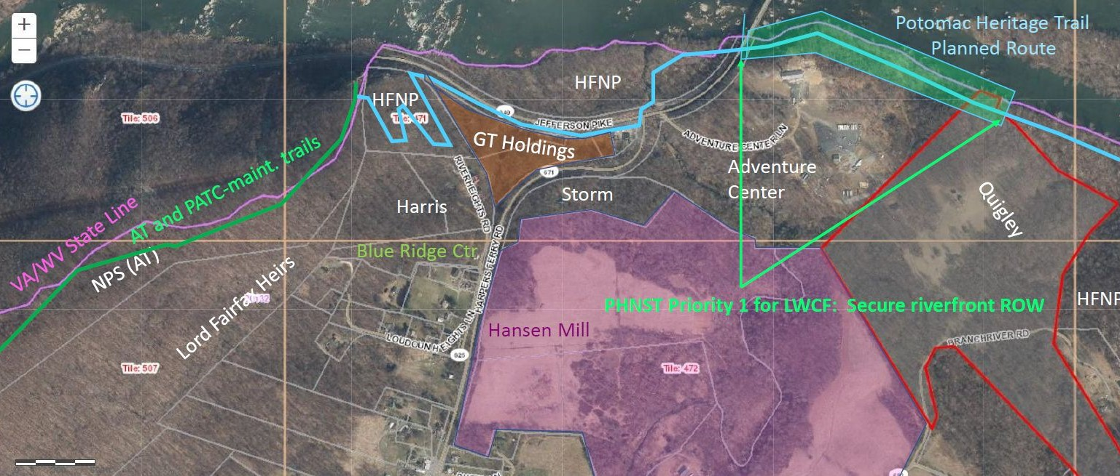
Two Major Steps Needed
Land Acquisition (LWCF)
Reopen Loudoun Hts Trail
(formerly part of the Appalachian Trail)

Slide 4
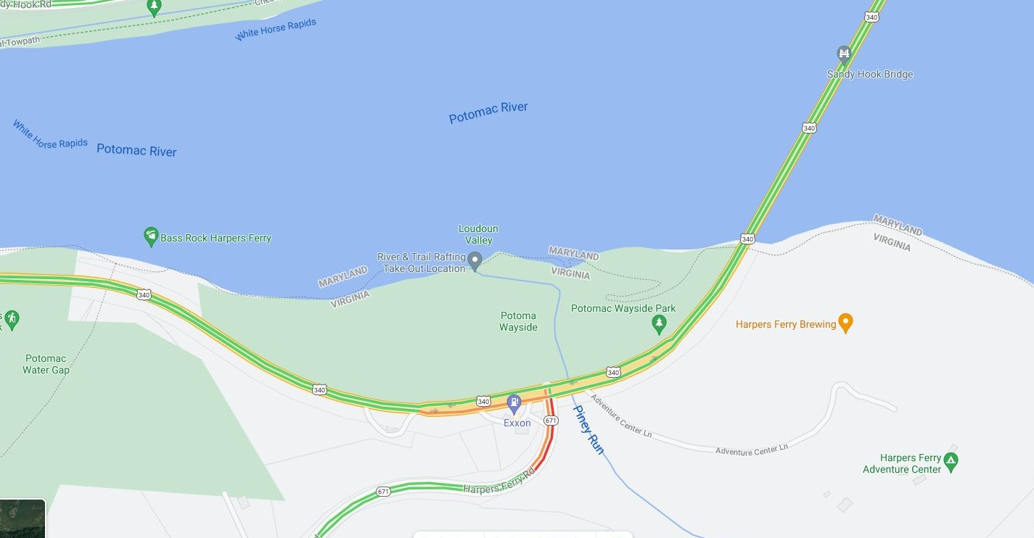
To Reopen Loudoun Heights Trail
(formerly part of the Appalachian Trail)
Need buy-in from HFNP
Need buy-in from VDOT
Use social trail here as part of Potomac Heritage National Scenic Trail
Permission to maintain it
Allow the Potomac Heritage Trail
To pass under 340, along the
19th century roadway, once we have
Buy-in from NPS on west, HFAC on east
Need permission to maintain it.
Open VDOT-owned portion of
this parking lot for trailhead users
VDOT owns the 80% of it closest to road
Two R.O.W.
Needed here
(LWCF)
Quigley
HFAC
Need safe crossing
Of 340 at Rt 671

Slide 5
Opening Loudoun Heights Trail
Maintained by Potomac Appalachian Trail Club (1980s-1990s)
National Park Service part of trail is blue on map, next page.
Accessed by parking lot on Rt. 340 600 feet west of Rt 671 (Harpers Fy. Road)
Originally, two (bad) trail choices to get from parking lot to National Park
On private land (orange on map, next page)
Along the 340 guard rail (pink on map, next page)
Trail closed in late 1990s
We want to reopen it using a better, all-public route
The original trail on Nat. Park Service land (blue on map)
An existing natural surface trail on VDOT R.O.W. but well south of 340 (green on map)

Slide 6
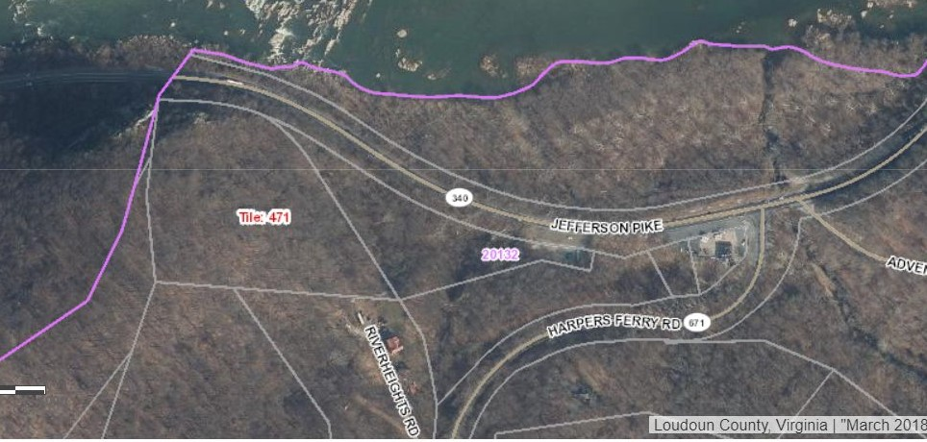
Loudoun Heights Trail in 1989 on NPS Land (now closed)
Accessed via Orange (on private land) or Red (along 340 guard rail)
VDOT right of way extends 60 feet south of Rt 340 pavement
NPS
Our proposed (green, blue) uses NEITHER orange nor red route;
Uses common-use natural surface trail 50 feet below, south of 340.
To Appalachian
Trail
1989 route: 0.33 miles steep
Switchback climb to Split Rock
private
VA State line
NPS
1989 route: 0.12 miles along old road
private
NPS
private
private

Slide 7
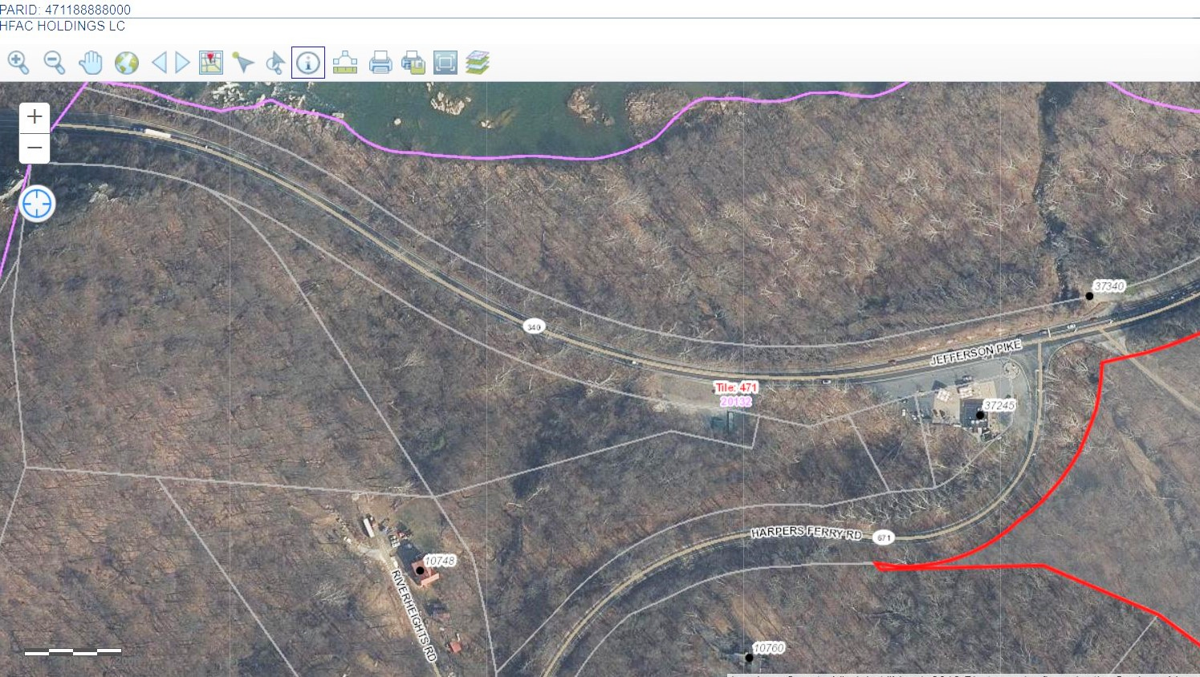
Trail is planned to continue under Rt. 340’s Potomac bridge, and east to Lovettsville
Existing trail we’d like to officially open as
Potomac Heritage Trail, on VDOT
Property but about 50’ from
Traffic on Rt. 340
Parking lot we’d like to reopen
For trail users.
Northern 80% is VDOT land
Southern 20% is private land
Trail crosses 340
at traffic light, continues east
on existing trails
Trail we are asking the National Park
Service to reopen.
Connects to Appalachian Trail

Slide 8
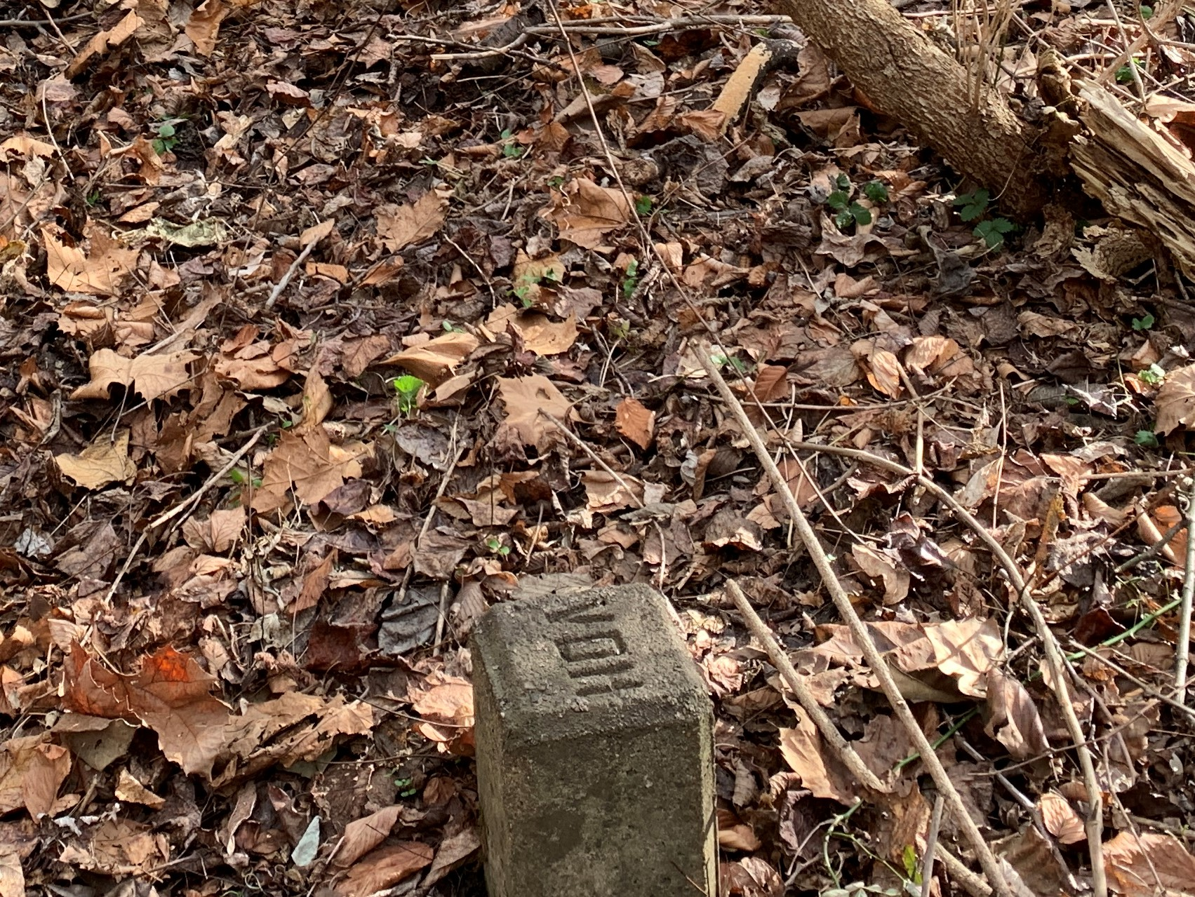
“VDH (VA Dept. Highways)” markers found at several points along green trail (previous slide). The markers help make clear that the trail stays on the VDOT side of the property line

Slide 9
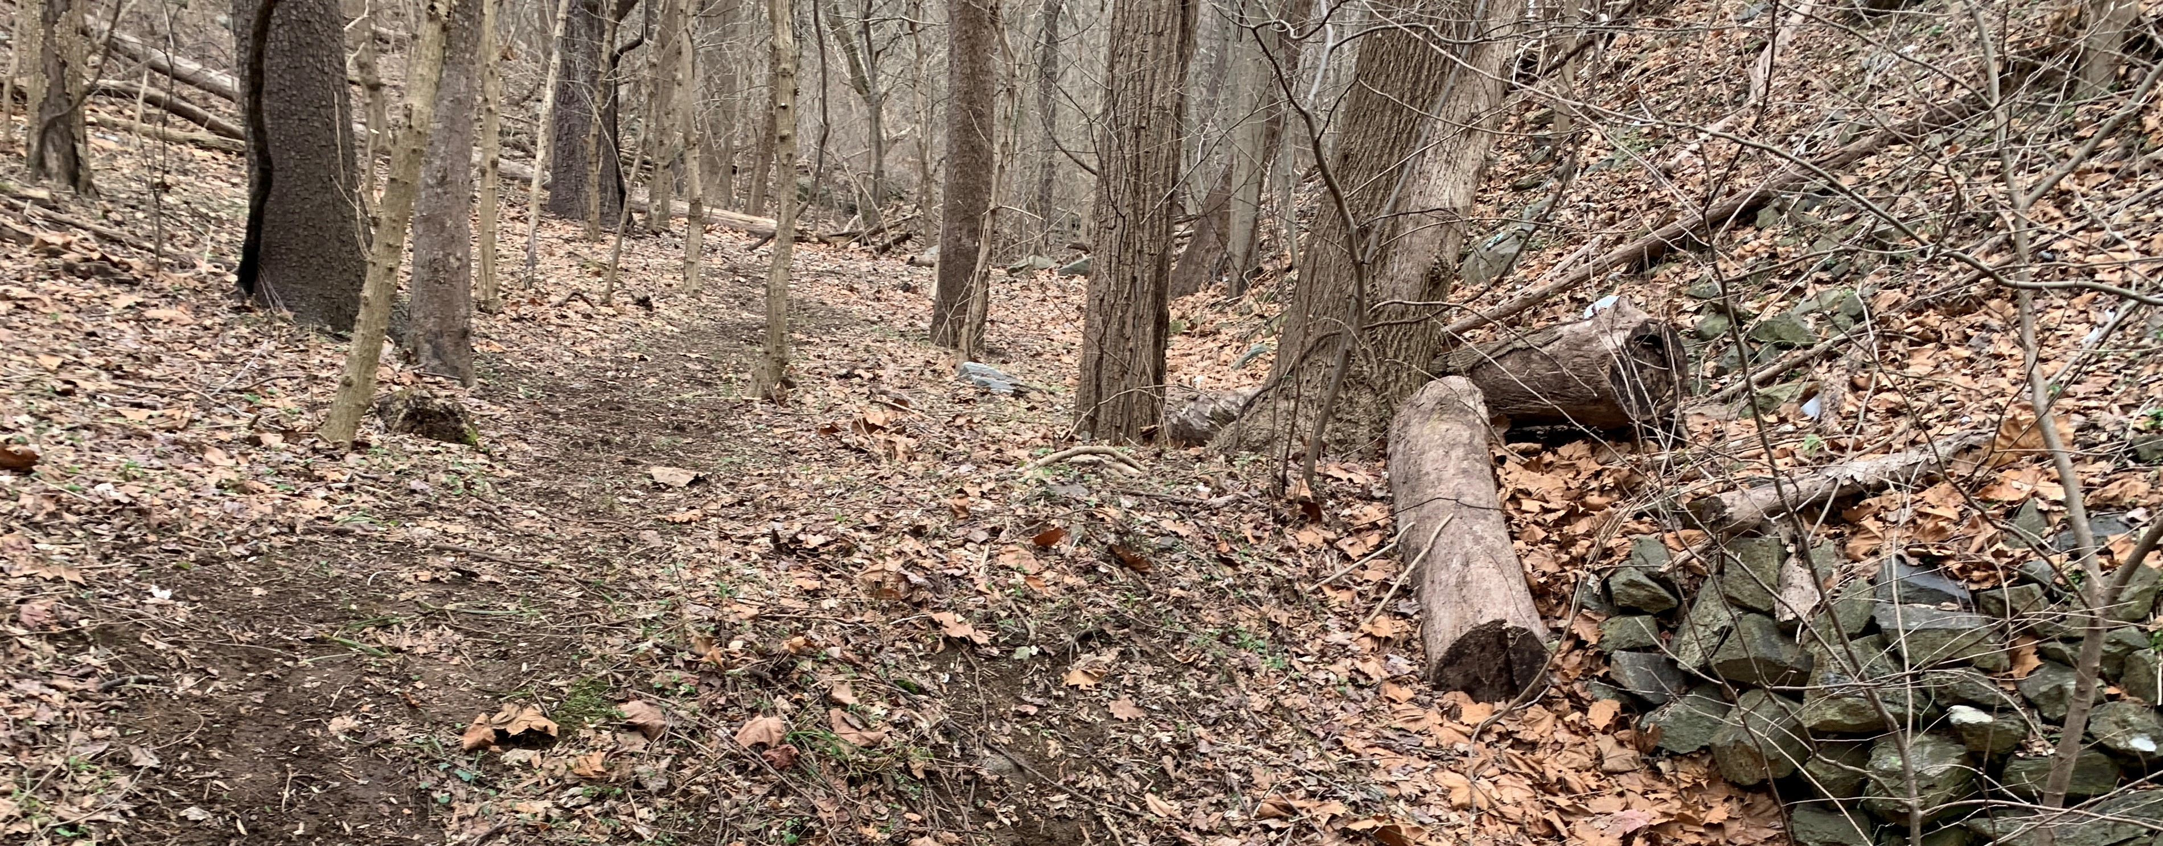
Route 340 traffic
Is high above the trail
(separated both horizontally and vertically from trail users)
Typical scene along the proposed (green) trail
Typical VDH property marker
Property Line private
VDOT

Slide 10
Next Steps to complete PHNST here
LWCF funds for two rights-of-way
We seek VDOT to:
Allow trail on their land south of Rt 340 to be designated as PHNST
Allow use of public part of parking lot (as shown on Slide 4)
Allow safe crossing of Rt. 340 at Rt 671
We seek NPS/HFNHP to:
Open, with help of volunteers, the part of the Loudoun Heights trail from Split Rock to Rt. 340 (this was part of the Appalachian Trail in the 1980s)
Allow use of Potoma Wayside for PHNST
May need a way to discourage boaters from landing here
Allow use of Short Hill for PHNST
Need route at Devils Elbow (where 19th century road has washed away)
Includes connection to Georges Mill Road
Small public parking lot should be developed at north end of Georges Mill Rd.

