Slide 1
The Potomac Heritage National Scenic Trail (PHNST) cannot cross Short Hill Mountain except at Harpers Ferry NHP

Slide 2
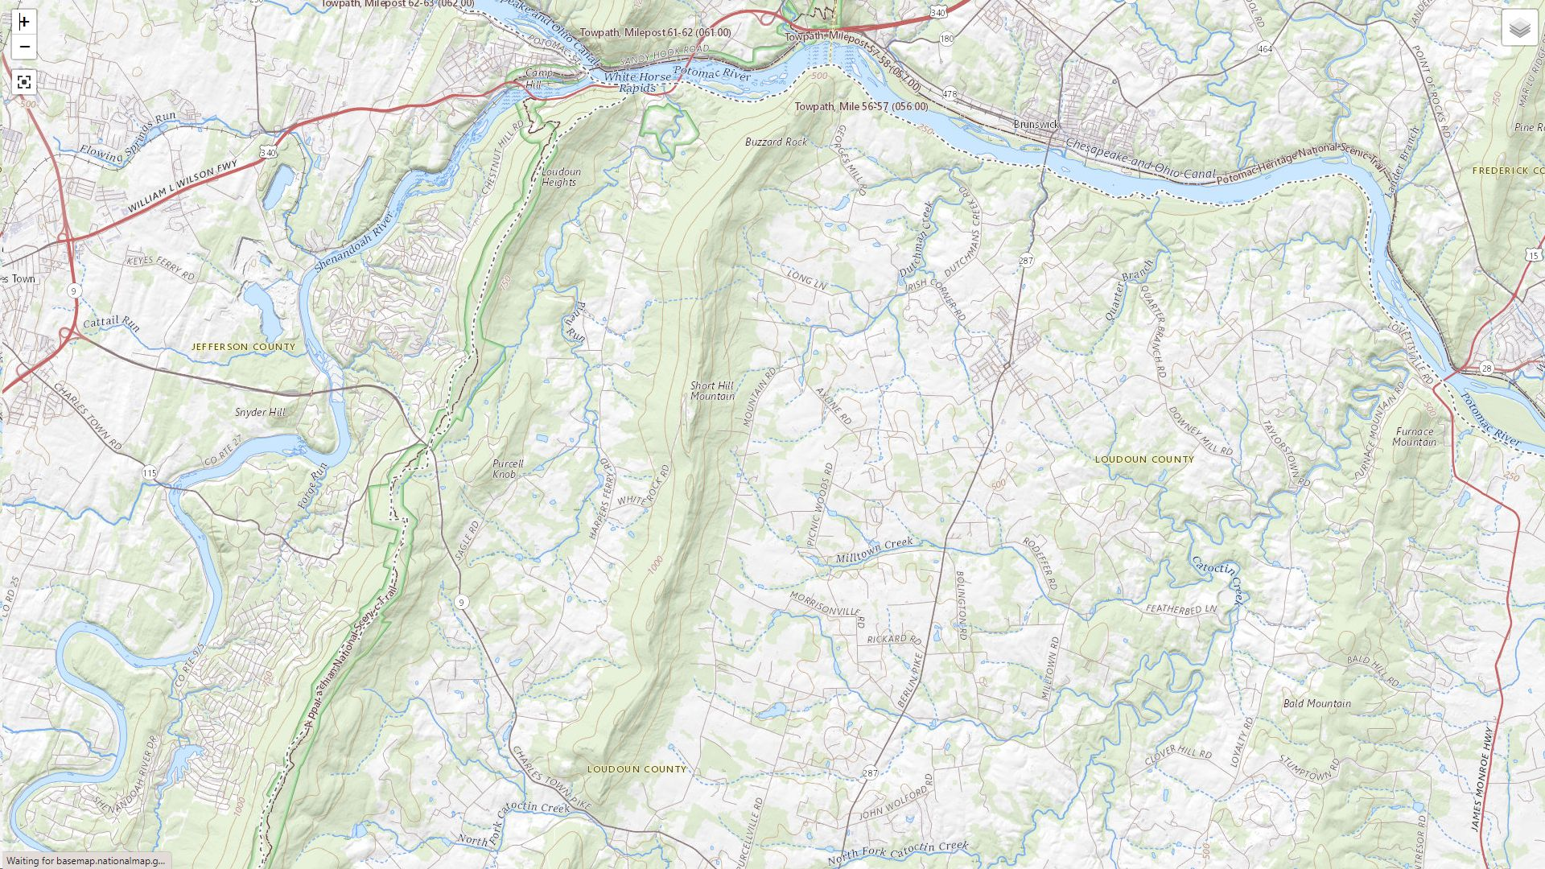
Harpers Ferry
NHP in green
The Devils Elbow
(where the Potomac
Cuts through Short Hill Mt.)
Short Hill Mountain is an impenetrable barrier to the PHNST.
It is 9 miles long, about 1000 feet high, extremely steep, and entirely private land except for HFNHP.
The walkable road network is to the east of Short Hill Mt. There are no walkable roads to the west.
The only possible PHNST route from Leesburg area to the Appalachian Trail must go through Harpers Ferry NHP at the Devils Elbow.
Appalachian Trail
(western terminus
of PHNST)
Short Hill Mt.
Network of unpaved, walkable roads
Only one N-S road,
paved, unwalkable
To Leesburg
Hillsboro, VA
Feasibility Study Area in blue

Slide 3
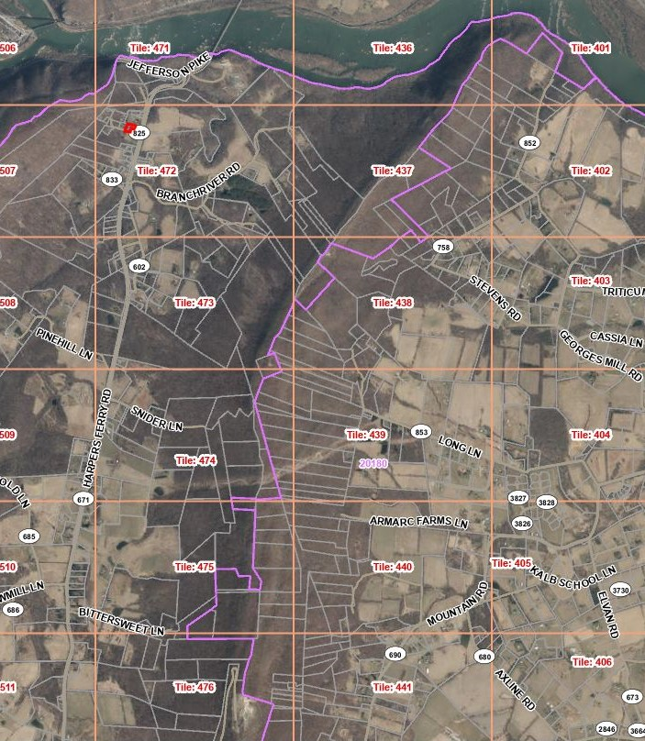
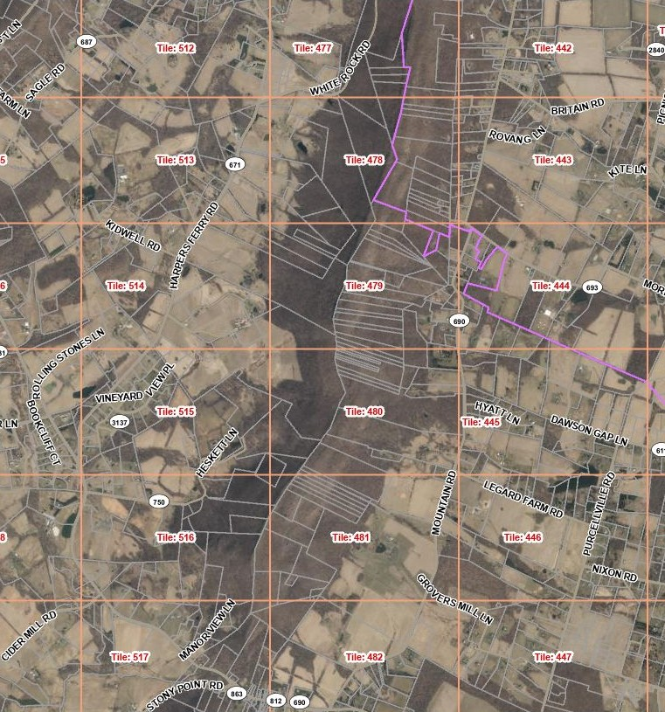
The Devils Elbow
Harpers Ferry
NHP in green
Map shows property lots along Short Hill Mountain.
All are private except for HFNHP.
Any PHNST crossing south of HFNHP faces:
- Extremely steep terrain
- Multiple private lots
- No walkable way north on the west side of Short Hill Mt.
Conclusion: the PHNST must pass through HFNHP.
Hillsboro, VA

